Slide 1
Artificial Intelligence for Games Week 10 – Direct Learning 1 Steve Rabin
For help on projects, email everyone (select and copy this string from the start of any class PowerPoint):
steve.rabin@gmail.com, p.jiankai@digipen.edu, b.hsu@digipen.edu, zak.s@digipen.edu, keaton.sullivan@digipen.edu, john.tseng@digipen.edu, a.roulst@digipen.edu
TAs: Jian Kai Phua, Brandon Hsu, Zak Stephenson, Keaton Sullivan, John Tseng, Andrew Roulst

Slide 2
Questions
Write down the moving average equation. What are some good values for alpha?
In player modeling, PrefersRocketLauncher is a traits
PrefersRocketLauncher can have a value in what range?
0 - 1
In player modeling, these things we’re tracking could describe a player’s Skill,Preference, Weaknesses.
In order to prioritize what to track about the player, what should you score in an Excel sheet?
Usage time
How hard to program
Tips and tricks
Matchmaking
Cheating

Slide 3
What is learning?
Learning is the act of acquiring new (or modifying):
Knowledge
Behaviors
Skills
Values
Preferences
Remembering outcomes and generalizing to future situations

Slide 4
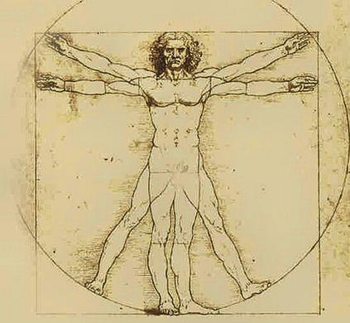
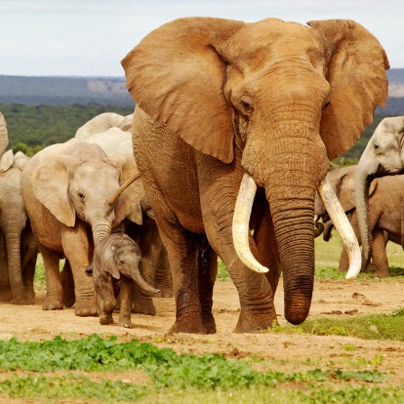
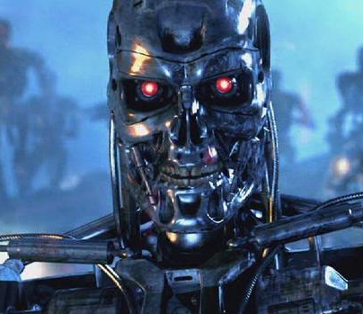
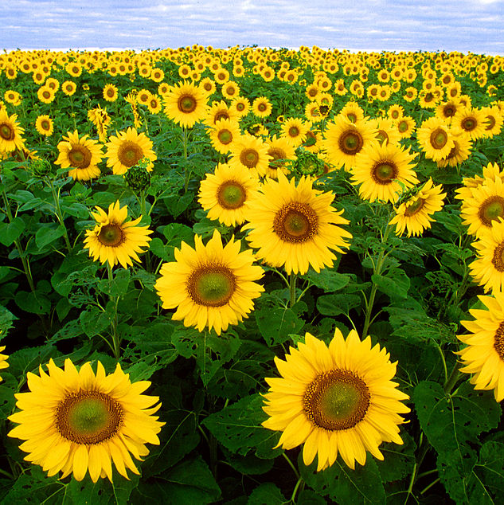
What is learning?
The ability to learn is possessed by:
Learning produces changes in the organism
Changes produced are relatively permanent

Slide 5
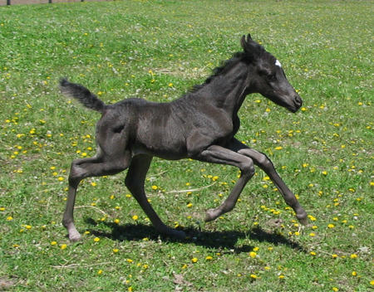
Two ways to learn
1. Creature learns over time
Gathers information about its environment and uses this information
If an animal eats something terrible, it learns not to eat that again
2. Creature’s innate inherited knowledge
Information that is genetically inherited
When a horse is born, it can immediately walk

Slide 6
Why make computers learn?
Computers can adapt to their users
Game opponents
Recommendation engines
Some things are too hard to program
Voice/handwriting/face recognition
Drive a car

Slide 7
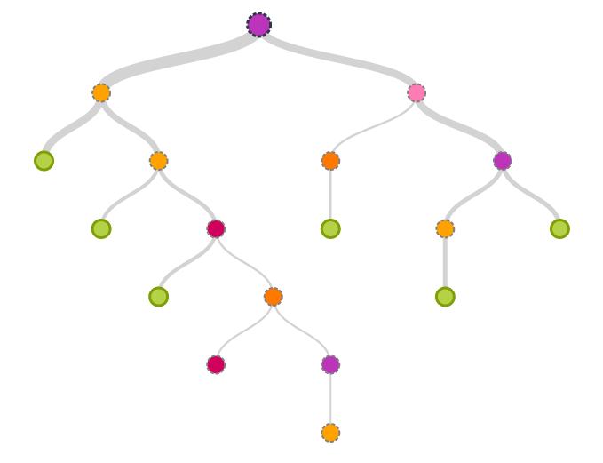
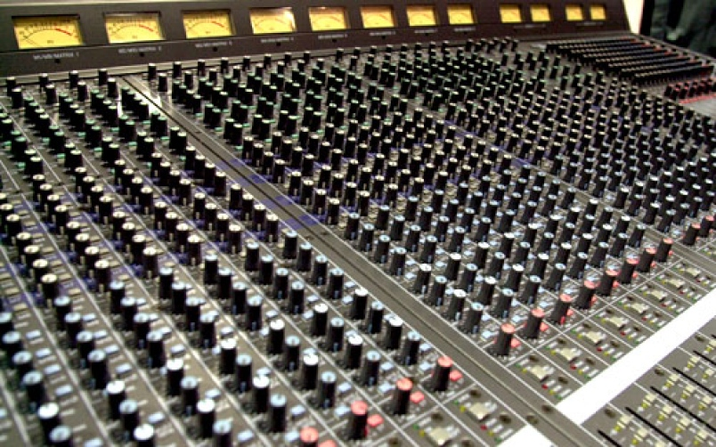
Direct vs Indirect Adaptation
Direct:
Can learn novel things
Might learn bad behaviors
Difficult to make/test
Indirect:
More predictable
Won’t behave badly
Easier to make/test

Slide 8
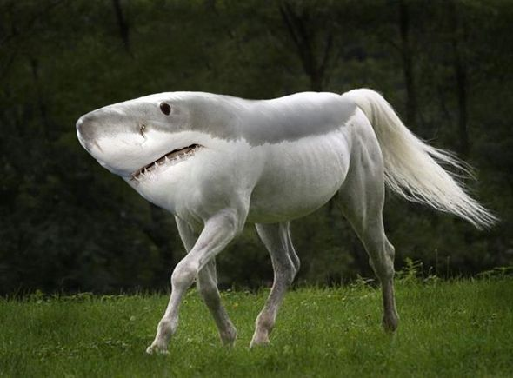
Direct it is!

Slide 9
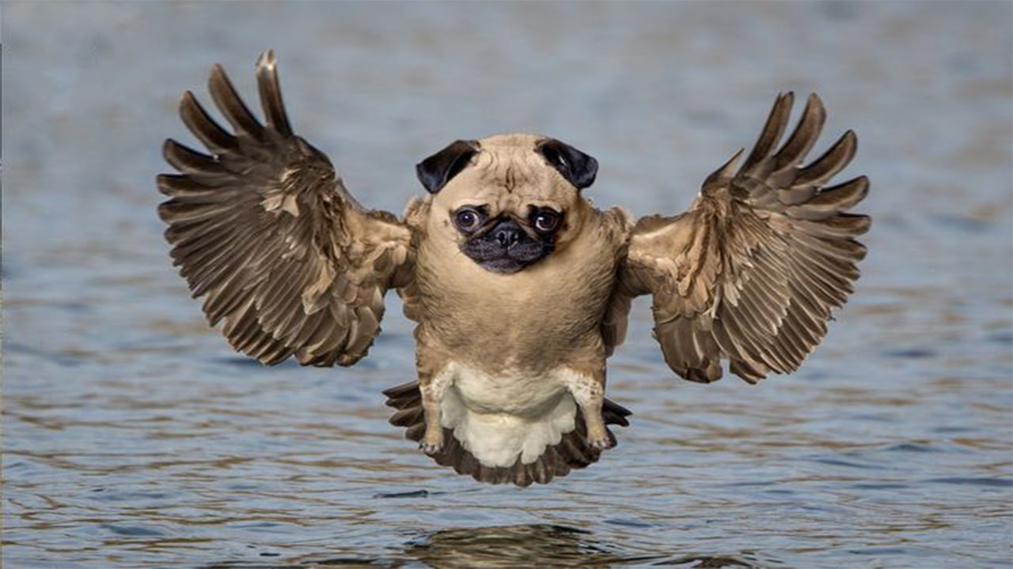
Direct it is!

Slide 10
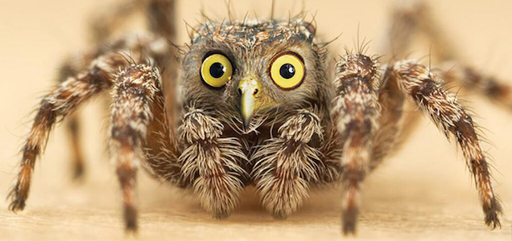
Direct it is!

Slide 11
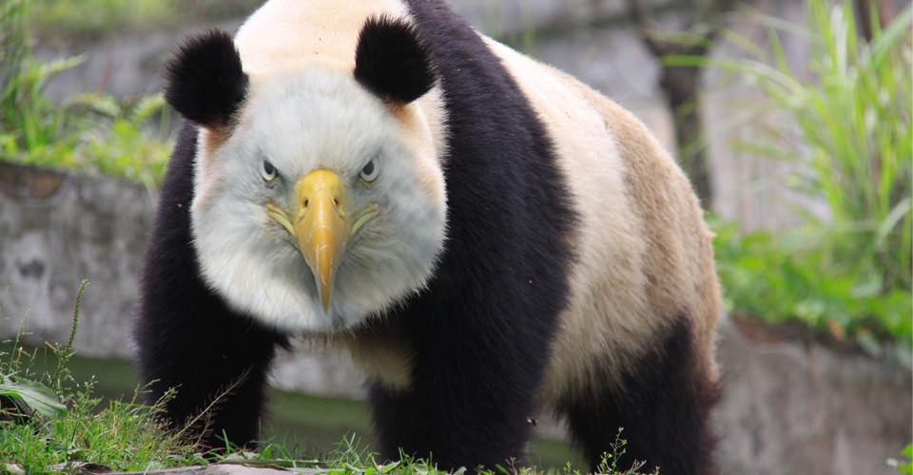
Direct it is!

Slide 12
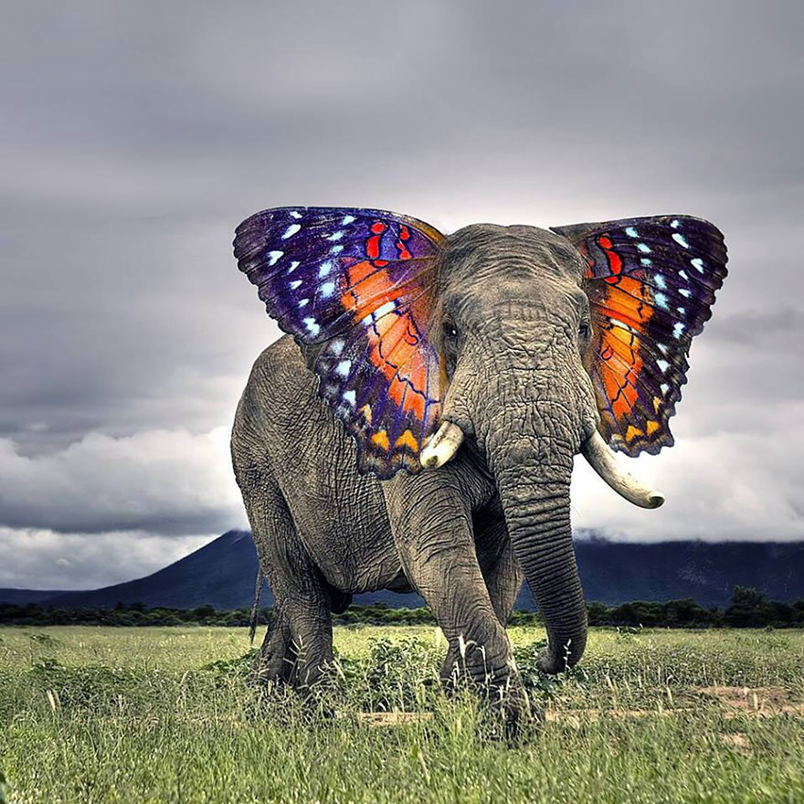
Direct it is!

Slide 13
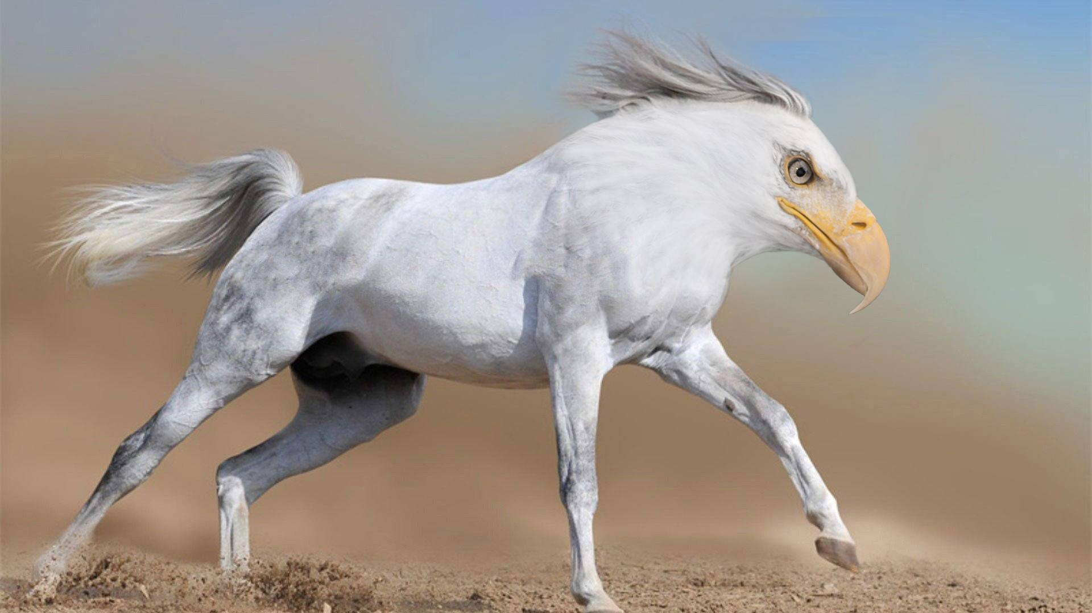
Direct it is!

Slide 14
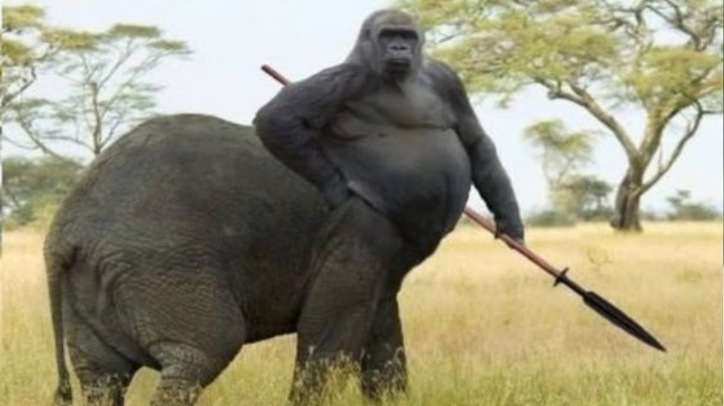
Direct it is!

Slide 15
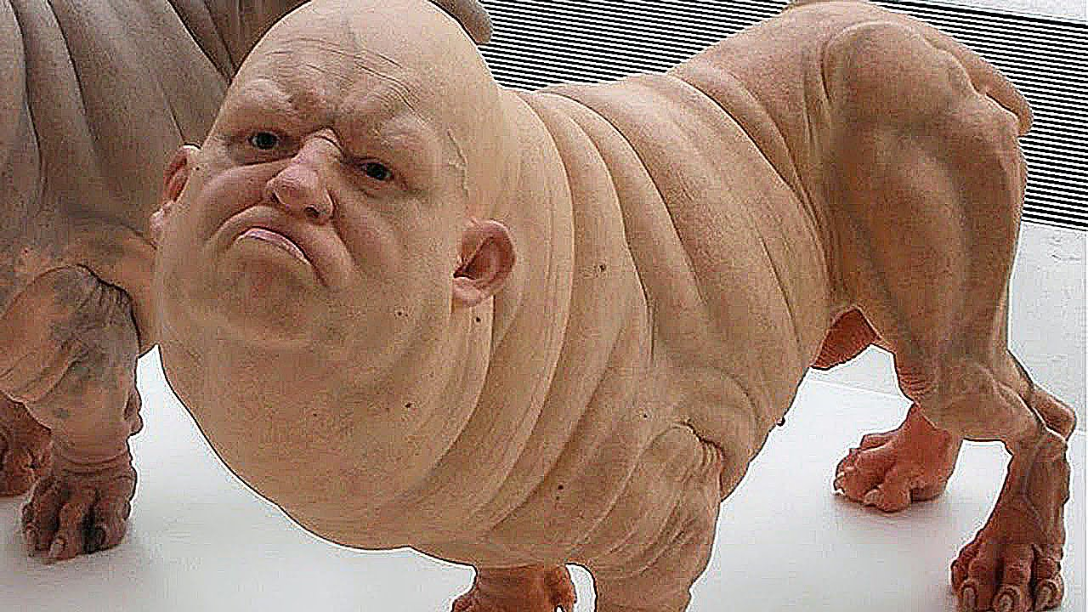
Direct it is!

Slide 16
Supervised and Unsupervised Learning

Slide 17
Unsupervised Learning Find interesting things about the data (clusters)

Slide 18
Unsupervised Learning Find interesting things about the data (clusters)

Slide 19
Unsupervised Learning Find interesting things about the data (clusters)

Slide 20
Unsupervised Learning Find interesting things about the data (clusters)

Slide 21
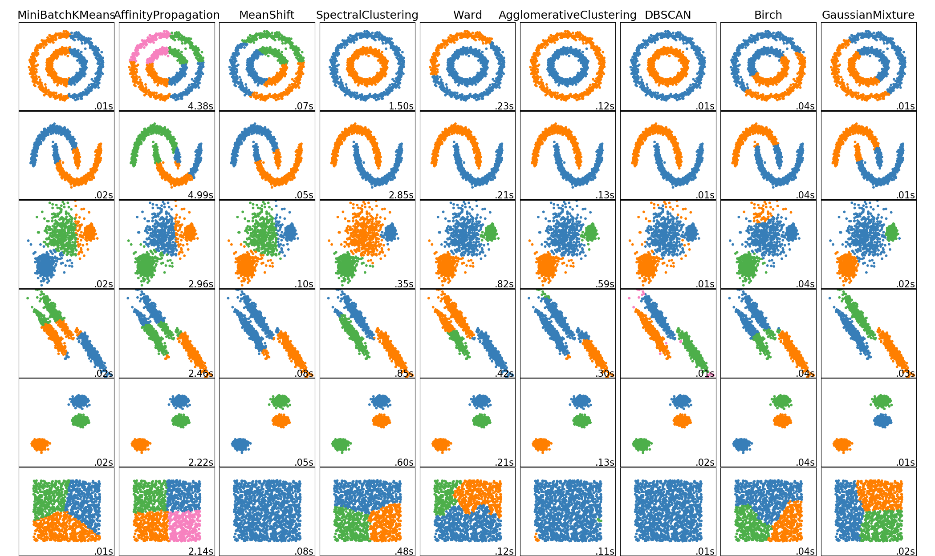

Slide 22
Supervised Learning Learns the association between the inputs and outputs
$
Square Footage

Slide 23
Supervised Learning Continuous output prediction = Regression
$
Square Footage

Slide 24
Supervised Learning Discrete output prediction = Classification
Malignant
Benign
Tumor Size

Slide 25
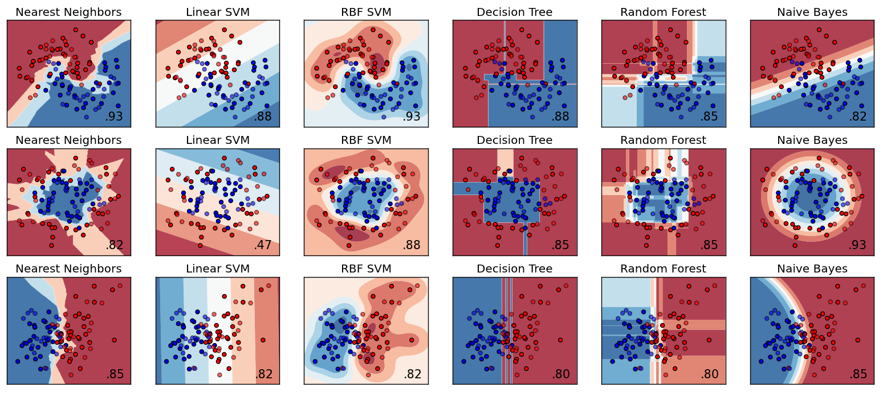

Slide 26
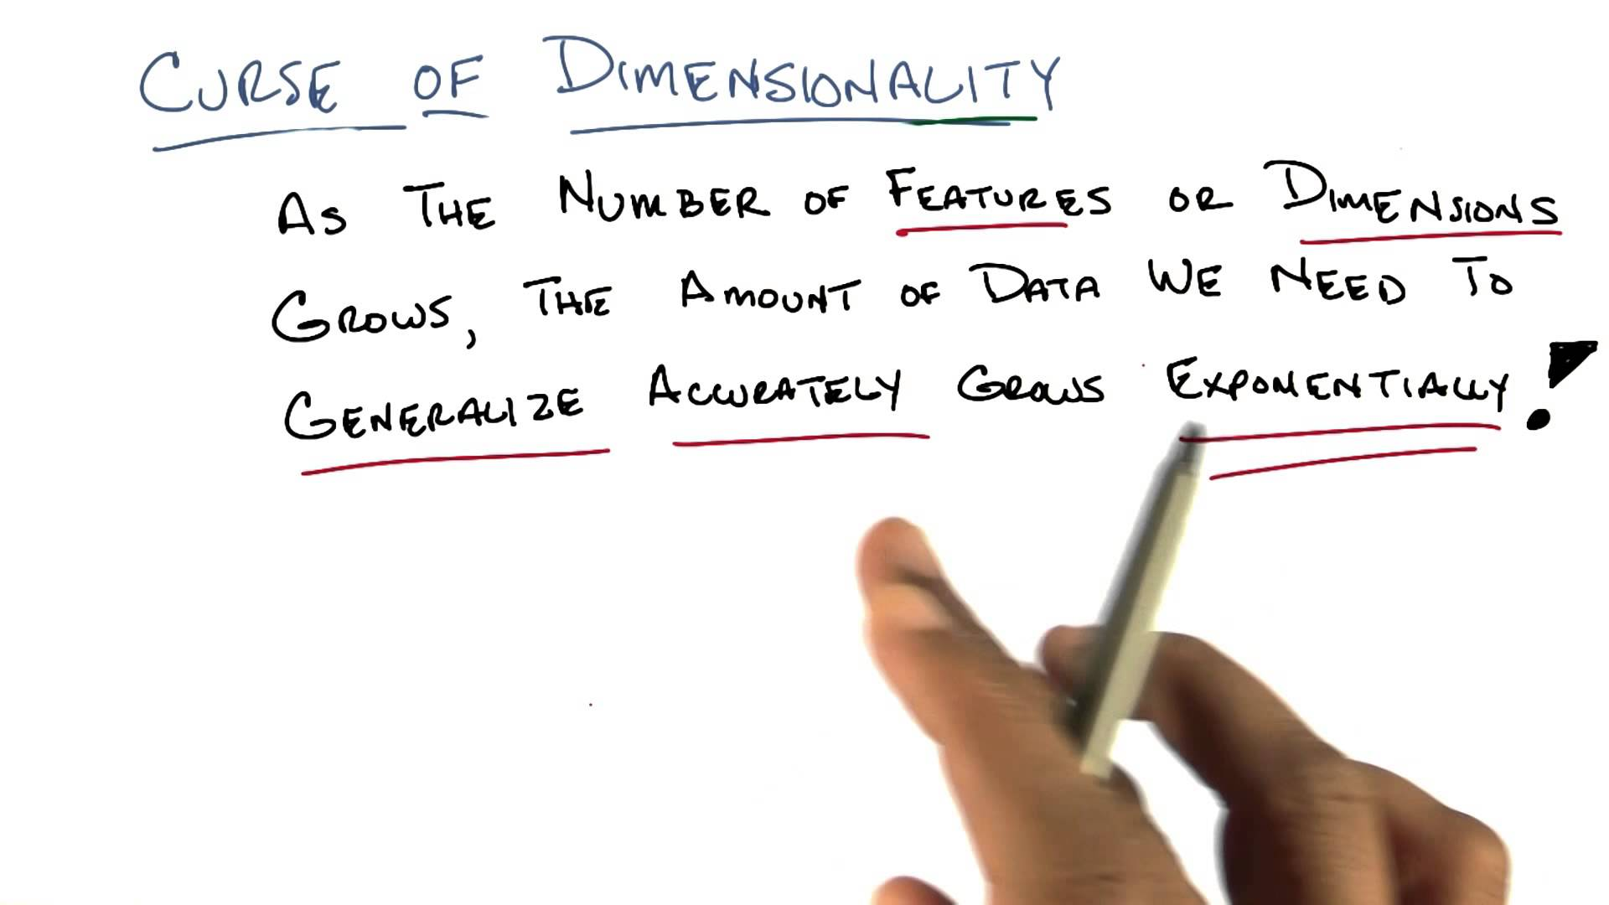

Slide 27
Supervised Learning Algorithms
Analytical learning
Artificial neural network
Backpropagation
Boosting (meta-algorithm)
Bayesian statistics
Case-based reasoning
Decision tree learning
Inductive logic programming
Gaussian process regression
Gene Expression Programming
Kernel estimators
Learning Automata
Minimum message length (decision trees, decision graphs, etc.)
Naive bayes classifier
Nearest Neighbor Algorithm
Probably approximately correct learning (PAC) learning
Ripple down rules, a knowledge acquisition methodology
Symbolic machine learning algorithms
Subsymbolic machine learning
Support vector machines
Random Forests
Ensembles of Classifiers
Ordinal classification
Data Pre-processing
Handling imbalanced datasets
Statistical relational learning
Proaftn, a multicriteria classification algorithm

Slide 28
Supervised Learning Algorithms
Analytical learning
Artificial neural network
Backpropagation
Boosting (meta-algorithm)
Bayesian statistics
Case-based reasoning
Decision tree learning
Inductive logic programming
Gaussian process regression
Gene Expression Programming
Kernel estimators
Learning Automata
Minimum message length (decision trees, decision graphs, etc.)
Naive bayes classifier
Nearest Neighbor Algorithm
Probably approximately correct learning (PAC) learning
Ripple down rules, a knowledge acquisition methodology
Symbolic machine learning algorithms
Subsymbolic machine learning
Support vector machines
Random Forests
Ensembles of Classifiers
Ordinal classification
Data Pre-processing
Handling imbalanced datasets
Statistical relational learning
Proaftn, a multicriteria classification algorithm

Slide 29
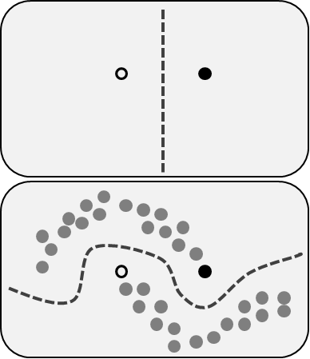
Semi-Supervised Learning

Slide 30
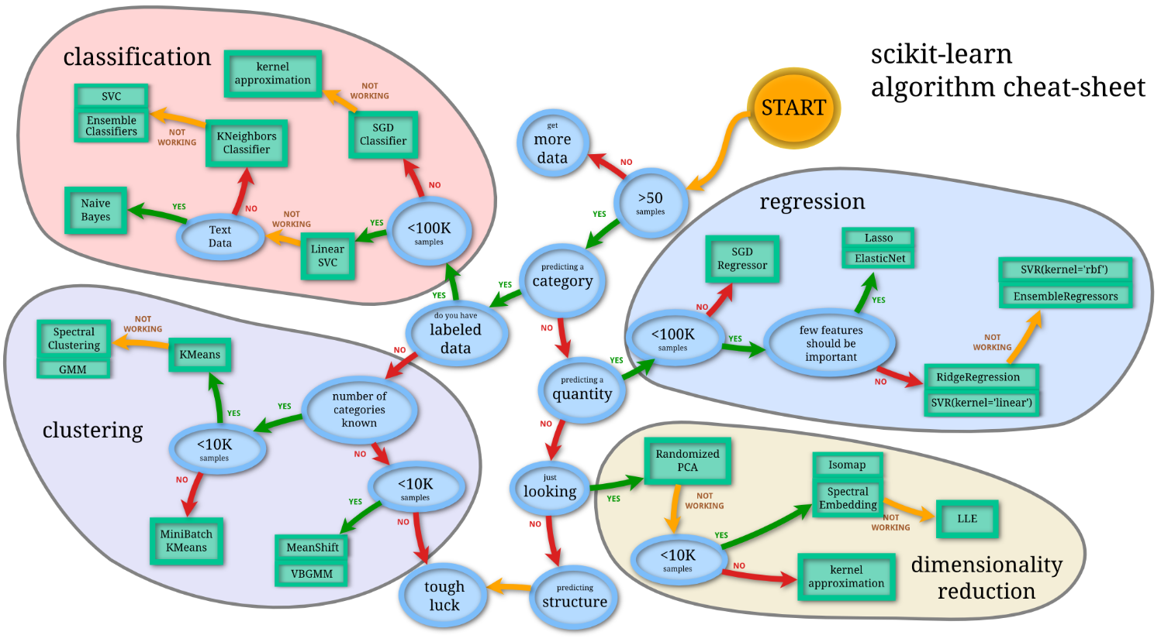

Slide 31
A visual introduction to machine learning
http://www.r2d3.us/visual-intro-to-machine-learning-part-1/
http://www.r2d3.us/visual-intro-to-machine-learning-part-2/

Slide 32
Machine Learning for Everyone
http://vas3k.com/blog/machine_learning/

Slide 33
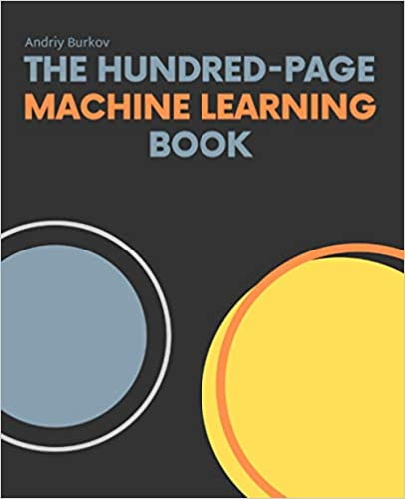

Slide 34
Metrics for Supervised learning algorithms
Algorithm | Ease of Tuning | Training Efficiency | Prediction Accuracy | Prediction Efficiency
Linear Regression | 4 | 4 | 2 | 4
Logistic Regression | 4 | 4 | 2 | 4
Decision Trees | 3 | 3 | 2 | 3
Random Forests | 3 | 2 | 3 | 2
Support Vector Machines | 2 | 2 | 3 | 2
Naïve Bayes | 4 | 4 | 2 | 4
K-Nearest Neighbors | 3 | 4 | 2 | 1
Gradient Boosting Machines | 2 | 2 | 3 | 3
XGBoost | 2 | 3 | 4 | 3
LightGBM | 2 | 4 | 4 | 4
CatBoost | 3 | 3 | 4 | 3
Deep Learning | 1 | 1 | 4 | 3
Convolutional Neural Networks | 1 | 1 | 4 | 3
Recurrent Neural Networks | 1 | 1 | 3 | 2
Long Short-Term Memory | 1 | 1 | 4 | 2

Slide 35
Linear Regression
Training
Efficiency
Deep Learning
Prediction
Efficiency
Ease of
Tuning
Prediction
Accuracy

Slide 36
Linear Regression
Naïve Bayes
Logistic Regression
Training
Prediction
K-Nearest Neighbors
Decision Trees
Random Forests
SVM
Gradient Boosting Machines
Efficiency
Efficiency
Deep Learning
CNN
LightGBM
Ease of Tuning
Accuracy
XGBoost
CatBoost
Recurrent Neural Networks
Long Short-Term Memory

Slide 37
K-Nearest
Neighbors
XGBoost
LightGBM
CatBoost
Naïve Bayes
Training
Training
Training
Training
Training
Efficiency
Efficiency
Efficiency
Efficiency
Efficiency
Ease of Tuning
Ease of Tuning
Ease of Tuning
Prediction
Prediction
Prediction
Prediction
Prediction
Efficiency
Efficiency
Efficiency
Efficiency
Efficiency
Accuracy
Accuracy
Accuracy
Accuracy
Accuracy

Slide 38
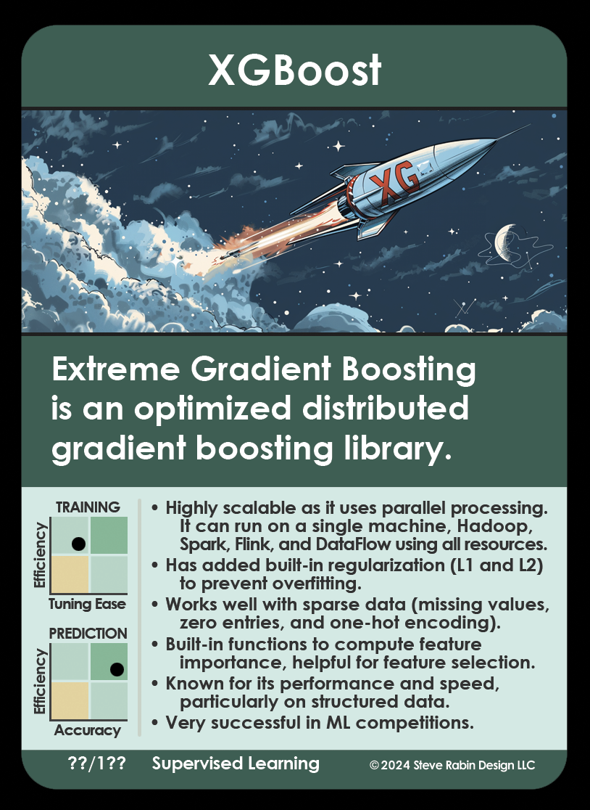
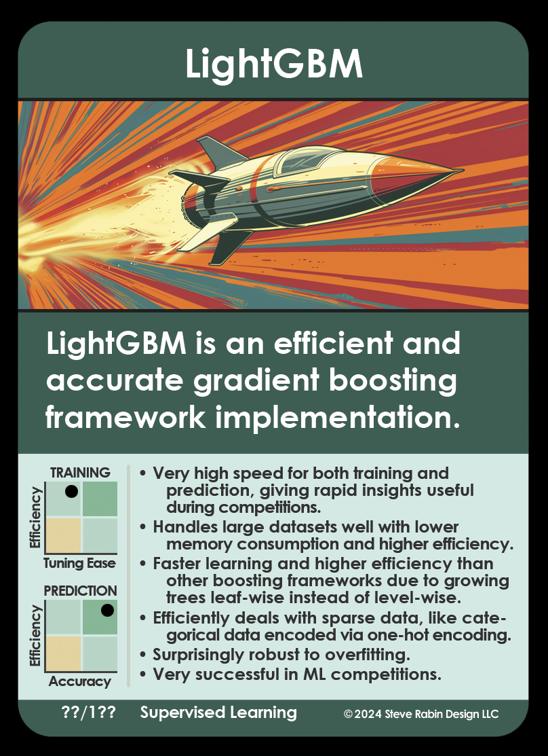

Slide 39
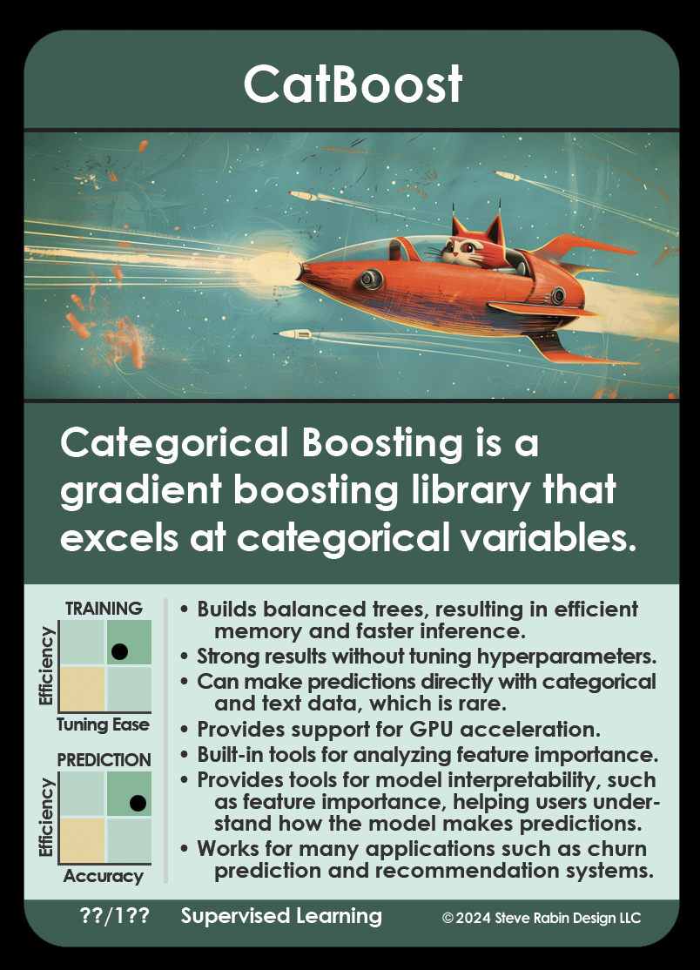
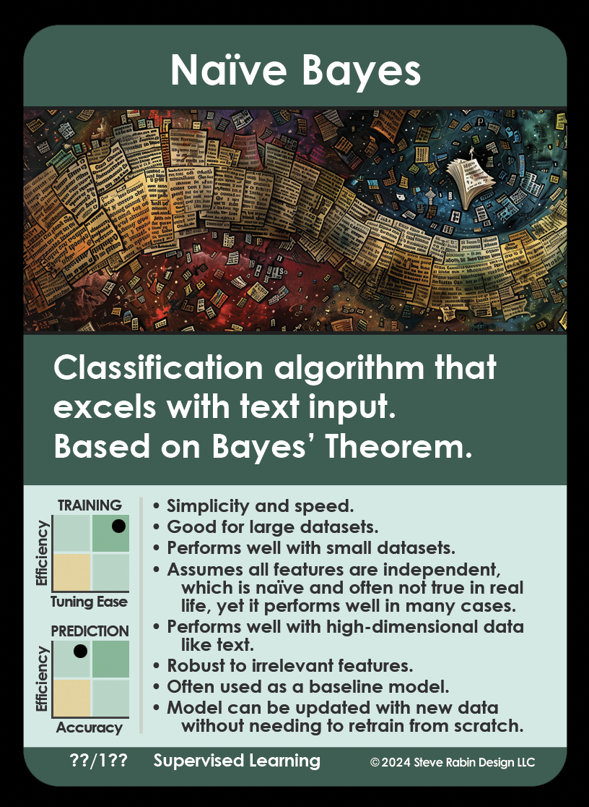

Slide 40
Quick and Dirty Intro to Neural Networks

Slide 41
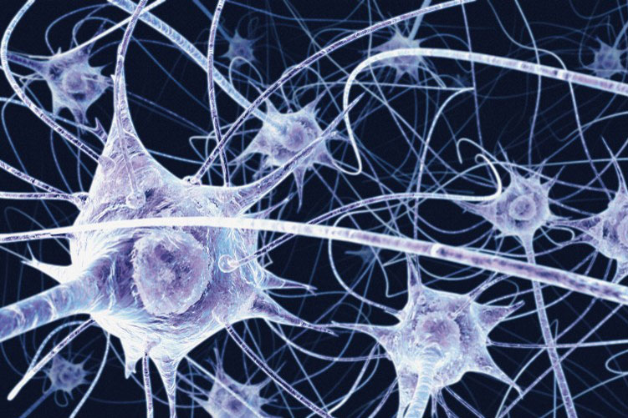
Artificial Neural Networks
Based on biological neurons in the brain
NNs are complex non-linear functions that relate one or more input variables to an output variable
NNs are a series of identical non-linear processing elements (analogous to neurons) connected together in a network by weights (analogous to synapses).

Slide 42


Slide 43

Artificial Neuron
Input₁
Weight₁
+
Input₂
Weight₂
Output
Weight₃
Input₃

Slide 44
Artificial Neuron
Inputs
Weights
Output
0.2
1.0
0.2
+
0.0
+
0.4
0.6
0.0
0.85
0.5
0.8

Slide 45

Artificial Neural Network

Slide 46
Train it to learn the relationship
?
?
?
?
?
?
?
?
?
?
?
?
?
?
?

Slide 47
Backpropagation

Slide 48
How many training samples?

Slide 49
Why is it a black box?

Slide 50
Did it learn the right thing? Do I have the right structure? Are the input features ideal?

Slide 51
Fix the bug?

Slide 52
Overfitting

Slide 53
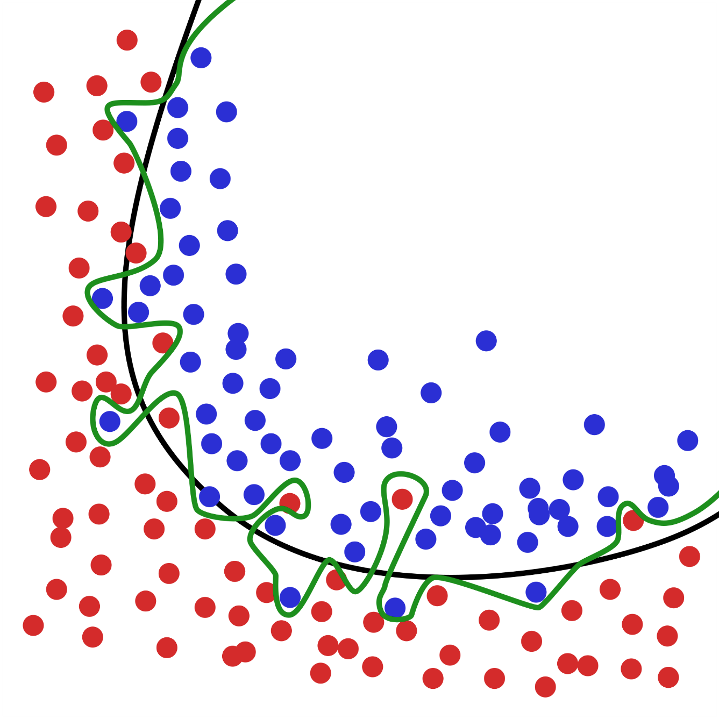
generalized
overfitting

Slide 54
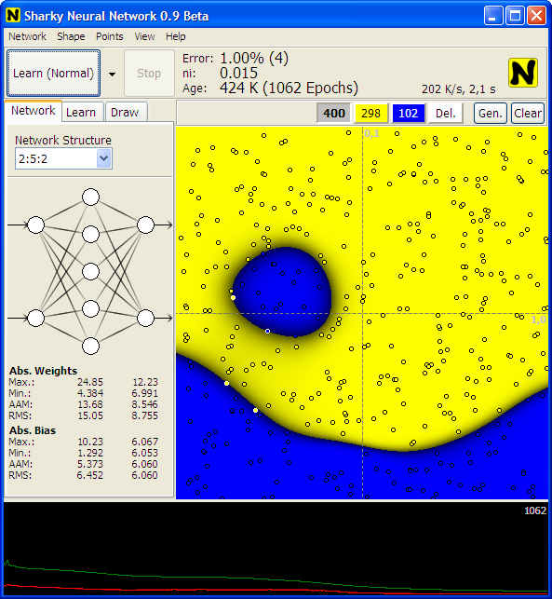
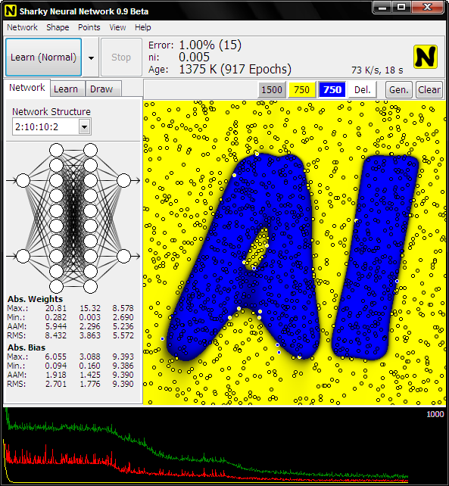

Slide 55
Artificial Neural Networks
Must be trained to produce a particular function
Not guaranteed to learn the right thing
Training data insufficient
Structure isn’t complex enough
Input features not ideal
Computationally fast once it is trained and frozen

Slide 56
What are ANNs good at?
Classification/recognition problems
Speech, faces, fingerprints, handwriting, gestures
NNs excel at taking noisy data and processing it to produce a match

Slide 57
Neural networks in games
Game success stories
Colin McRae Rally 2.0: Steering racing cars
Forza Motorsport “Drivatar”
Supreme Commander 2
Creatures: Control and learning
Bottom line:
Statistically, game developers are not using NNs

Slide 58
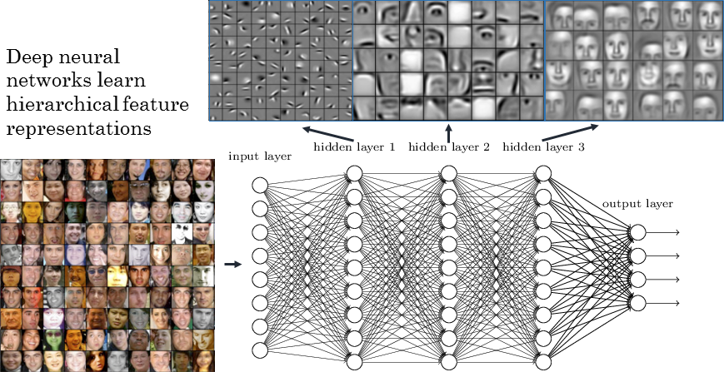

Slide 59
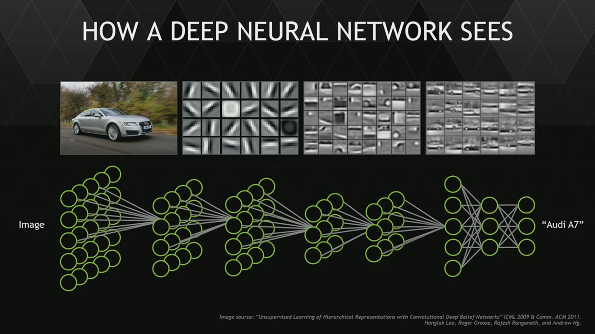

Slide 60
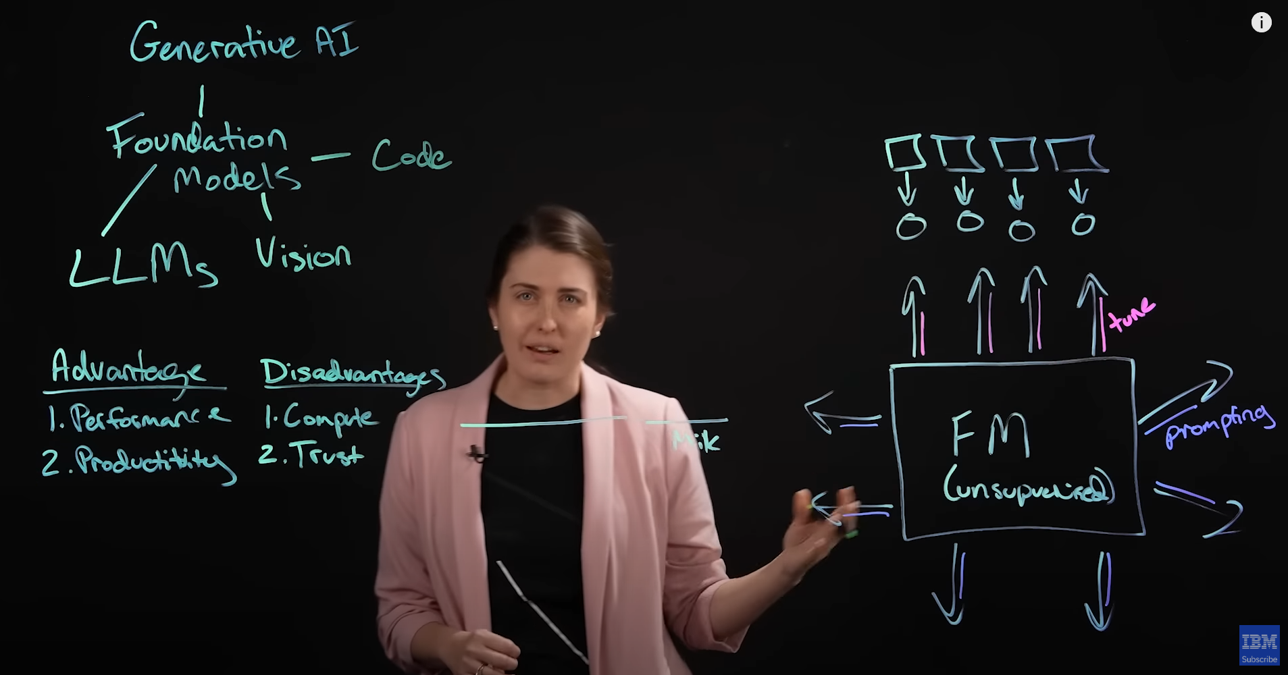
Generative Models
https://www.youtube.com/watch?v=hfIUstzHs9A

Slide 61
Perceptron: Single layer neural network
Simpler version of a NN – Single-layer
Easier to train
Outputs a “yes” or “no”
Either it gets stimulated enough to trigger, or it does not
Drawback:
Can only learn simple (linearly separable) functions

Slide 62
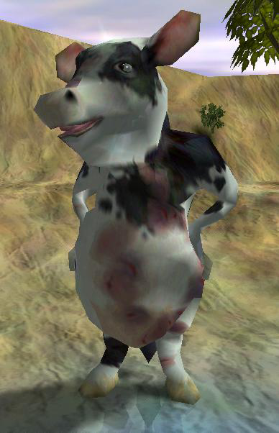


Slide 63
Perceptrons in Black & White
Inputs: Hunger, Tasty food, Unhappiness

Slide 64
Desire Sources |  |  |  |  |  | Actual | Intended (Feedback)
Hunger |  | Tastiness |  | Unhappiness
Value | Weight | Value | Weight | Value | Weight
0.8 | 0.500 | 0.8 | 0.500 | 0 | 0.500 | 0.800 | 1.000
0.8 | 0.564 | 0.2 | 0.564 | 0 | 0.500 | 0.564 | 1.000
0.1 | 0.599 | 0.6 | 0.573 | 0 | 0.500 | 0.404 | 0.200
0 | 0.597 | 0 | 0.560 | 1 | 0.500 | 0.500 | 0.002
0.3 | 0.597 | 0.4 | 0.560 | 1 | 0.450 | 0.853 | 0.400
- | 0.58341 | - | 0.542 | - | 0.4047 | - | -

Slide 65
Desire Sources |  |  |  |  |  | Actual | Intended (Feedback)
Hunger |  | Tastiness |  | Unhappiness
Value | Weight | Value | Weight | Value | Weight
0.8 | 0.500 | 0.8 | 0.500 | 0 | 0.500 | 0.800 | 1.000
0.8 | 0.564 | 0.2 | 0.564 | 0 | 0.500 | 0.564 | 1.000
0.1 | 0.599 | 0.6 | 0.573 | 0 | 0.500 | 0.404 | 0.200
0 | 0.597 | 0 | 0.560 | 1 | 0.500 | 0.500 | 0.002
0.3 | 0.597 | 0.4 | 0.560 | 1 | 0.450 | 0.853 | 0.400
- | 0.58341 | - | 0.542 | - | 0.4047 | - | -

Slide 66
Desire Sources |  |  |  |  |  | Actual | Intended (Feedback)
Hunger |  | Tastiness |  | Unhappiness
Value | Weight | Value | Weight | Value | Weight
0.8 | 0.500 | 0.8 | 0.500 | 0 | 0.500 | 0.800 | 1.000
0.8 | 0.564 | 0.2 | 0.564 | 0 | 0.500 | 0.564 | 1.000
0.1 | 0.599 | 0.6 | 0.573 | 0 | 0.500 | 0.404 | 0.200
0 | 0.597 | 0 | 0.560 | 1 | 0.500 | 0.500 | 0.002
0.3 | 0.597 | 0.4 | 0.560 | 1 | 0.450 | 0.853 | 0.400
- | 0.58341 | - | 0.542 | - | 0.4047 | - | -

Slide 67
Desire Sources |  |  |  |  |  | Actual | Intended (Feedback)
Hunger |  | Tastiness |  | Unhappiness
Value | Weight | Value | Weight | Value | Weight
0.8 | 0.500 | 0.8 | 0.500 | 0 | 0.500 | 0.800 | 1.000
0.8 | 0.564 | 0.2 | 0.564 | 0 | 0.500 | 0.564 | 1.000
0.1 | 0.599 | 0.6 | 0.573 | 0 | 0.500 | 0.404 | 0.200
0 | 0.597 | 0 | 0.560 | 1 | 0.500 | 0.500 | 0.002
0.3 | 0.597 | 0.4 | 0.560 | 1 | 0.450 | 0.853 | 0.400
- | 0.58341 | - | 0.542 | - | 0.4047 | - | -

Slide 68
Desire Sources |  |  |  |  |  | Actual | Intended (Feedback)
Hunger |  | Tastiness |  | Unhappiness
Value | Weight | Value | Weight | Value | Weight
0.8 | 0.500 | 0.8 | 0.500 | 0 | 0.500 | 0.800 | 1.000
0.8 | 0.564 | 0.2 | 0.564 | 0 | 0.500 | 0.564 | 1.000
0.1 | 0.599 | 0.6 | 0.573 | 0 | 0.500 | 0.404 | 0.200
0 | 0.597 | 0 | 0.560 | 1 | 0.500 | 0.500 | 0.002
0.3 | 0.597 | 0.4 | 0.560 | 1 | 0.450 | 0.853 | 0.400
- | 0.58341 | - | 0.542 | - | 0.4047 | - | -

Slide 69
Desire Sources |  |  |  |  |  | Actual | Intended (Feedback)
Hunger |  | Tastiness |  | Unhappiness
Value | Weight | Value | Weight | Value | Weight
0.8 | 0.500 | 0.8 | 0.500 | 0 | 0.500 | 0.800 | 1.000
0.8 | 0.564 | 0.2 | 0.564 | 0 | 0.500 | 0.564 | 1.000
0.1 | 0.599 | 0.6 | 0.573 | 0 | 0.500 | 0.404 | 0.200
0 | 0.597 | 0 | 0.560 | 1 | 0.500 | 0.500 | 0.002
0.3 | 0.597 | 0.4 | 0.560 | 1 | 0.450 | 0.853 | 0.400
- | 0.58341 | - | 0.542 | - | 0.4047 | - | -

Slide 70
Desire Sources |  |  |  |  |  | Actual | Intended (Feedback)
Hunger |  | Tastiness |  | Unhappiness
Value | Weight | Value | Weight | Value | Weight
0.8 | 0.500 | 0.8 | 0.500 | 0 | 0.500 | 0.800 | 1.000
0.8 | 0.564 | 0.2 | 0.564 | 0 | 0.500 | 0.564 | 1.000
0.1 | 0.599 | 0.6 | 0.573 | 0 | 0.500 | 0.404 | 0.200
0 | 0.597 | 0 | 0.560 | 1 | 0.500 | 0.500 | 0.002
0.3 | 0.597 | 0.4 | 0.560 | 1 | 0.450 | 0.853 | 0.400
- | 0.583 | - | 0.542 | - | 0.404 | - | -

Slide 71
Decision Tree Learning
Algorithms exist to create decision trees in near real-time
ID3
C4.5
CART
CHAID
MARS
Conditional Inference Trees
Yes
Health
Low?
No
Die
Yes
Ammo
Low?
No
Die
Live

Slide 72
What Creature Ate | Feedback (how tasty)
A big rock | -1.0
A small rock | -0.5
A small rock | -0.4
A tree | -0.2
A cow | +0.6
What objects will satisfy a Creature’s desire to eat?

Slide 73
Pick decisions that minimize entropy (Random outcomes result in entropy of 1)

Slide 74
Anger Decision Tree
What Creature Attacked | Feedback from Player
Friendly, weak, Celtic | -1.0
Enemy, weak, Celtic | +0.4
Friendly, strong, Norse | -1.0
Enemy, strong, Norse | -0.2
Friendly, weak, Greek | -1.0
Enemy, medium, Greek | +0.2
Enemy, strong, Greek | -0.4
Enemy, medium, Aztec | 0.0
Friendly, weak, Aztec | -1.0

Slide 75
Anger Decision Tree
What Creature Attacked | Feedback from Player
Friendly, weak, Celtic | -1.0
Enemy, weak, Celtic | +0.4
Friendly, strong, Norse | -1.0
Enemy, strong, Norse | -0.2
Friendly, weak, Greek | -1.0
Enemy, medium, Greek | +0.2
Enemy, strong, Greek | -0.4
Enemy, medium, Aztec | 0.0
Friendly, weak, Aztec | -1.0

Slide 77
Metaheuristic and Stochastic Optimization
Genetic Algorithms
Simulated Annealing
Quantum Annealing
Probability Collectives
Reactive Search
Optimization
Cross-Entropy Method
Random Search
Stochastic Tunneling
Parallel Tempering
Stochastic Hill Climbing
Swarm Algorithms
Tabu Search
Extreme Optimization

Slide 78
Evolutionary Algorithms
Genetic Algorithms
Genetic Programming
Evolutionary Programming
Gene Expression Programming
Evolution Strategy
Memetic Algorithm
Differential Evolution
Neuroevolution
Learning classifier system

Slide 79
Genetic Algorithms

Slide 80
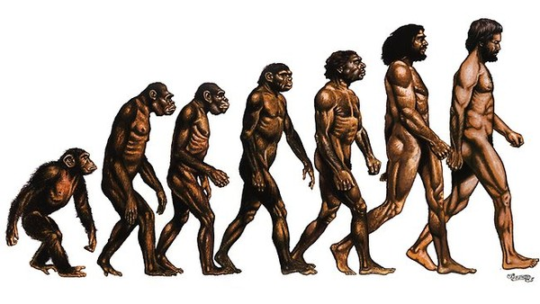
Genetic Algorithms
Based on evolutionary principals
Collection of genes forms a chromosome
All combinations of genes defines the search space
A chromosome defines a point in the search space

Slide 81
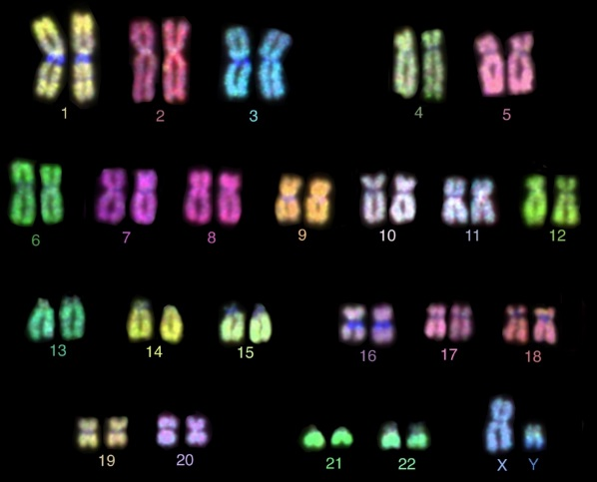
Genetic Algorithms
Create a population of chromosomes
Select the best chromosomes
Mate best to create a new generation
Crossover
Mutation
Elitism

Slide 82
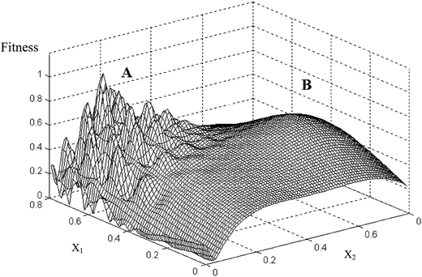
Genetic Algorithms
GAs outperform many other techniques when search space contains many optima

Slide 83
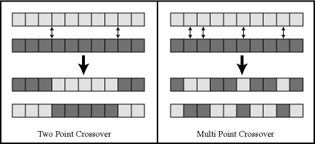
Crossover

Slide 84
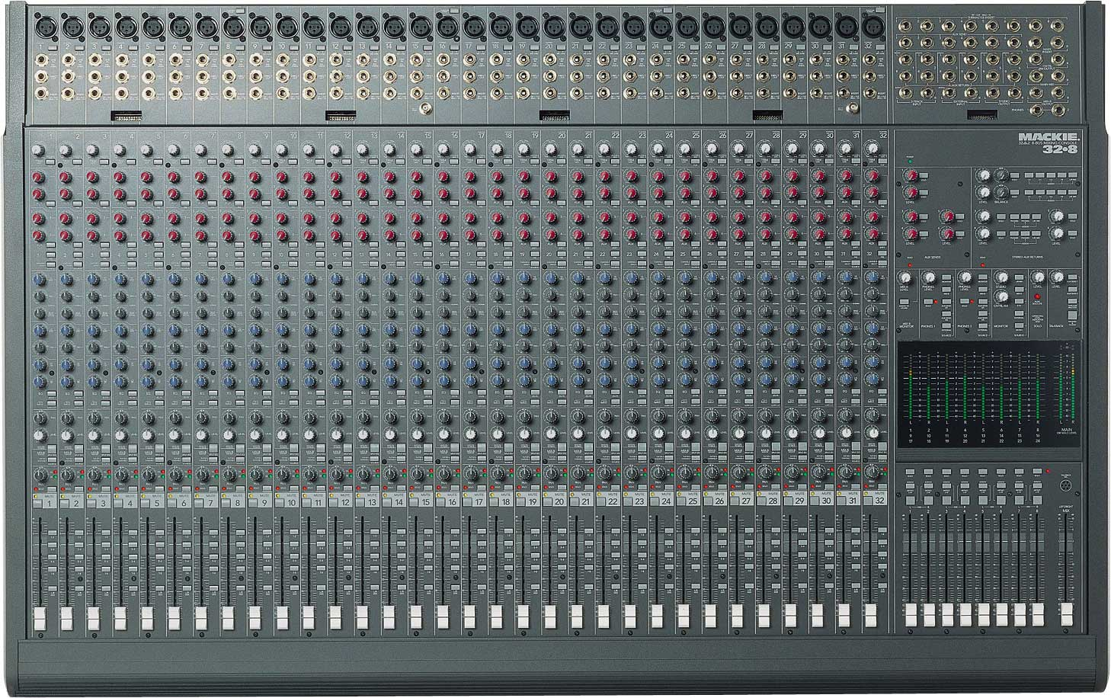
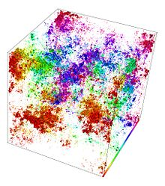
Genetic Algorithms: Optimization

Slide 85
Genetic Algorithms
Optimization technique
Not very useful for game development
Not guaranteed to find an optimal solution
Could be used during development to discover the best combination of settings

Slide 86
Genetic Algorithms Demos
Genome encoding:
Steering | Throttle | Steering | Throttle | …
BoxCar2D
http://boxcar2d.com/

Slide 87
Movie Time!

